Slide 1
C PROGRAMMING LANGUAGE
Huaidong Chen
45503784@qq.com
Tel: 13368123785

Slide 2
Introduction to the Course
54 class hours, including lectures and experiments
Examination and Assessment
References

Slide 3
Grading system
Assignments and Class performance 20%.
eg. attendance rate, quality of your finished assignments.
Lab performance 20%
Final Examination 60%.

Slide 4
References
C programming：a Q&A Approach，H.H.Tan etal. McGraw-Hill Education
The C programming lanugage (second edition), K&R, Brian W.Kernighan&Dennis M. Ritchie. China Machine Press.
Open courses online
imooc, study.163.com,coursera

Slide 5
Introduction
Operating System/Platform
Programming Languages
Programming Languages Learning
Software Developing

Slide 6
Platform
peripherals
USB
CPU
Central Processing Unit
X86
ARM
DSP
PowerPC
MCS-51
MIPS
macrochip
Extern storage
CPU and peripherals
Single Chip Machine
microcontroller
System On Chip
Single Board Computer
Graphic Card
Sound Card
memory
SRAM
SRAM
DDR
DDR2
DDR3
A/D
D/A
Ethernet
……
Internal BUS
CPU BUS
ISA
PCI
PCI express

Slide 7

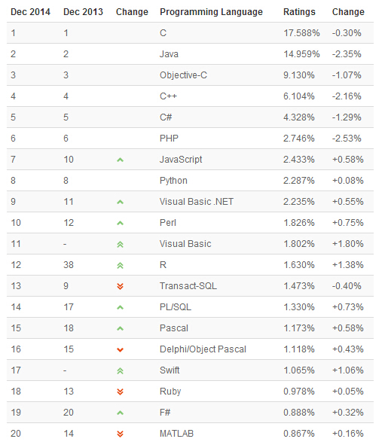
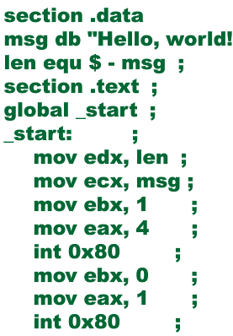
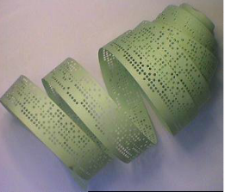
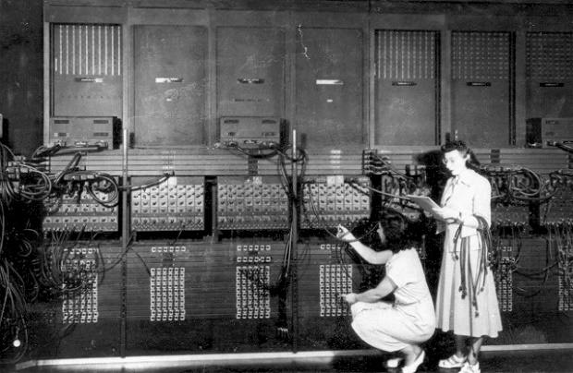

Programming Languages History
Machine Code
Assemble
FORTRAN 1957
John Backus
Formula Translator
C++ 1983
TIOBE 2014-12
Objective-C1986
Perl 1987
LISP 1958
Python1991
COBOL 1959
PHP1995
BASIC1964
Beginners All purpose Symbolic Instruction Code
Ruby1995
JavaScript1995
PASCAL 1970
Java1995
C 1972 UNIX
Ken Thompson & Dennis Ritchie
C# 2001
.NET 2001
SWIFT 2014

Slide 8


Operating System History
No OS
Mac OS
From BSD
Mac OS X 10.0 Cheetah
Mac OS X 10.1 Puma
Mac OS X 10.2 Jaguar
Mac OS X 10.3 Panther
Mac OS X 10.4 Tiger
Mac OS X 10.5 Leopard
Mac OS X 10.6 Snow Leopard
Mac OS X 10.7 Lion
OS X 10.8 Mountain Lion
OS X 10.9 Mavericks
OS X 10.10 Yosemite
Windows
Windows 3.1
Windows 95
Windows 98
Windows 2000/NT
Windows Vista
Windows XP
Windows 7
Windows 8
VxWorks
uC/OS II
ECOS
Symbian
Android
iPhoneOS/iOS
Unix V1 1971
SunOS 1986
based on BSD4.1
Unix V3 1973
Kernel by C
Fedora
Debian
Mandrake
Ubuntu
Red Hat Linux
SuSE
Linux Mint
Gentoo
CentOS
FreeBSD 1993
BSD V1 1978
Berkeley Software Distribution
NetBSD 1993
OpenBSD 1995
Unix V7 1971
MINIX1987
Linux 1991
Linus Torvalds
OS and GUI
Kernel, Library and User software
Software with OS
Usersoftware
Library
OS API
OS
Hardware

Slide 9
Programming Languages Learning
Types
Procedure
Object Oriented
Script
IDE and Code Logic
Algorithm
Real Programming: Error processing, I/O, Protocol, API, IDE

Slide 10
THE INTRODUCTION TO PROGRAMMING
1. Computer Language(programming language)
the language that computer can understand
2. Era of programming language
first： Machine Language
second： Assemble Language
third： Higher Level Language:
Procedure Oriented language
e.g. BASIC、FORTRAN、PASCAL、C etc.
Object Oriented language
e.g. C++、Visual BASIC、Java etc.
intellectualized language

Slide 11
Hello world
1.1 Getting Started
1.2 Variables and Arithmetic Expressions
1.3 The for statement
1.4 Symbolic Constants

Slide 12
Chapter 1 - A Tutorial Introduction
In this chapter we will concentrate on: the structure of program in C and the writing rules

Slide 13
Features of C
C possess Assembly Language’s advantages and High Language’s advantages
1. Simple, compact , agile,convenient to use
2. C has a variety of different data types and
abundant operators
3. Structural control statements
4. object program is efficient
5. Better portable（than assemble language）
6. Can control hardware directly

Slide 14
THE STRUCTURE OF PROGRAM IN C
AND THE WRITING RULES
MAIN STRUCTURE OF PROGRAM IN C
A C program, whatever its size, consists of functions , every program must have a main somewhere,may have others functions
[ex. 1.1] A C program, consists of a main()
main()
{ printf(“This is a C program.\n”);
}
Result:
This is a C program.

Slide 15
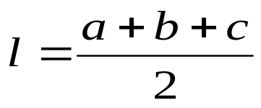
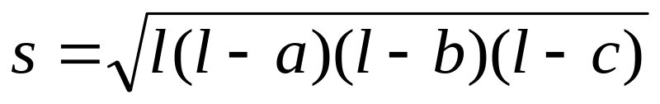
[ex. 1.2] Input length of three border in atriangle，output the atriangle’s area.
formula:
#include <stdio.h>
#include <math.h>
main()
{ float a,b,c,l,s;
scanf(“%f%f%f”,&a,&b,&c);
l=(a+b+c)/2;
s=sqrt(l*(l-a)*(l-b)*(l-c));
printf(“s=%f\n”,s);
}

Slide 16
[ ex. 1.3] A C program has two functions, main() and max().
int max(int x, int y)
{ return( x>y ? x : y ); }
void main()
{ int num1,num2;
printf(“Input the first integer number: ”);
scanf(“%d”, &num1);
printf(“Input the second integer number: ”);
scanf(“%d”, &num2);
printf(“max=%d\n”, max(num1, num2));
}
Result：
Input the first integer number:6↙
Input the second integer number:9↙
max=9

Slide 17
1. Function is the basic unit of a C program
C is functional language，it is prone to modularize.
ANSI C provides more then 100 library routines
TC provides more then 300 library routines
a routnie which is writed ourselves
2. main() function
Each program begins executing at the beginning of main() ,moreover where it is.
When main() is executed, and the entire program is finished.

Slide 18
[ex. 1.4]Structure of main()
#include <stdio.h>
#include <math.h>
main()
{ float a,b,c,l,s; declarations
scanf(“%f%f%f”,&a,&b,&c);
l=(a+b+c)/2;
s=sqrt(l*(l-a)*(l-b)*(l-c)); statements
printf(“s=%f\n”,s);
}
function body

Slide 19
WRITING RULES OF PROGRAM
1. every statement must be ended by “;”
2. a program line may include several statements and a statement can write in several lines
3. use comment
Lines between /* and */ are a comment, which in this case explains briefly what the program does. Any characters between /* and */ are ignored by the compiler; they may be used freely to make a program easier to understand. Comments may appear anywhere where a blank, tab or newline can.

